Slide 1
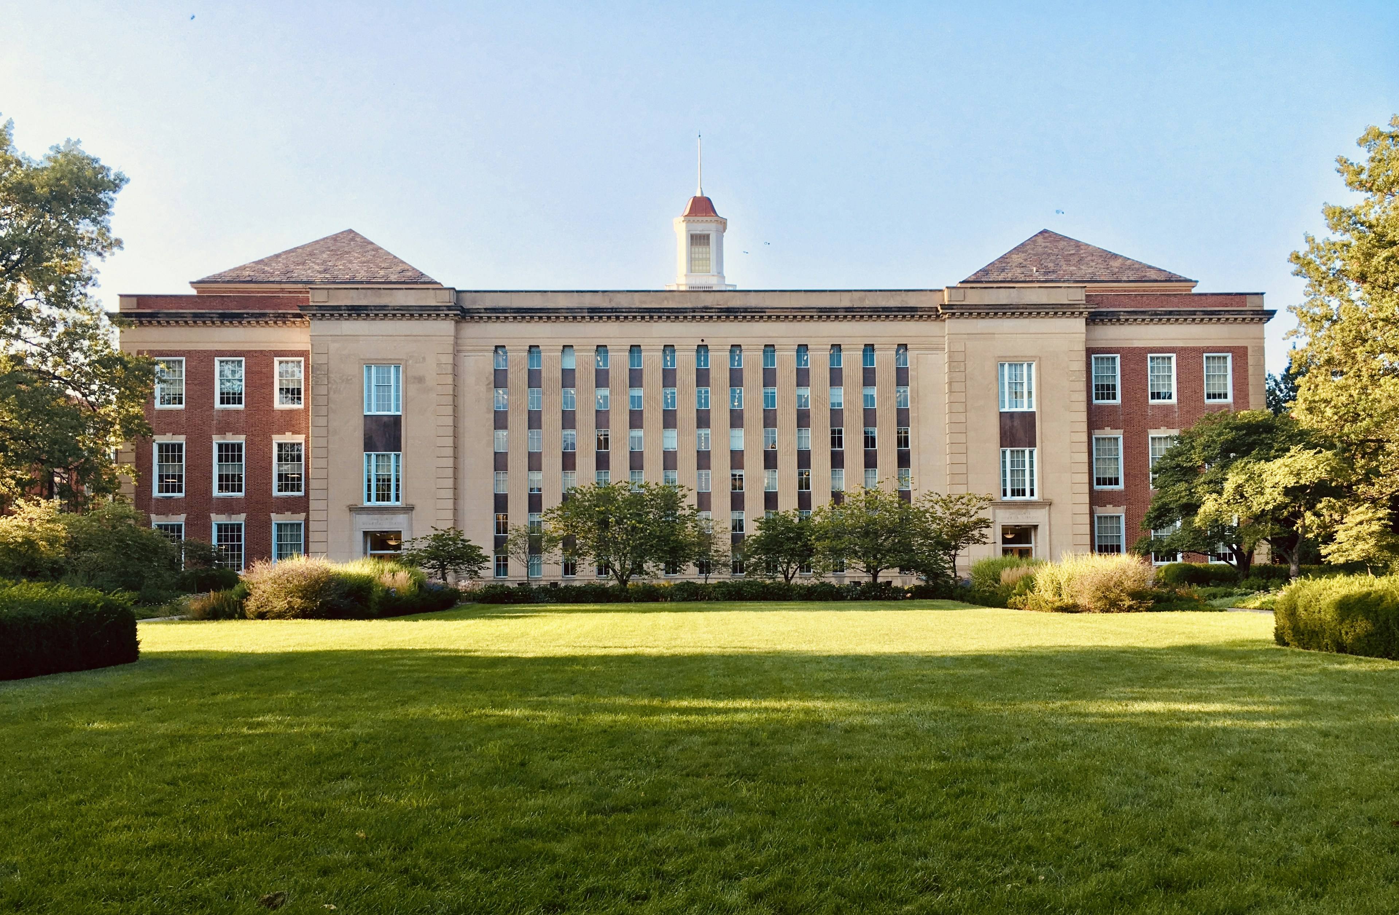
GLOBAL COLLEGE OF ENGINEERING & TECHNOLOGY, KADAPA
Approved by AICTE | Affiliated to JNTUA | Recognized by UGC & ISO 9001-2015

Slide 2

agenda
Introduction
Courses Offered
Key Facilities
Placements & Security
Contact Information

Slide 3


The power of EDUCATION

Slide 4

About the College
30 Acres lush green campus on NH-40
Modern infrastructure with Gymnasium & Sports Centre
Experienced faculty with GATE coaching
Industrial tours and guest lectures for practical exposure

Slide 5

Admission Codes
EAMCET
ECET
I-CET
PG CET
POLYCET
Use Code: GLBC

Slide 6

Courses Offered
B.Tech: Civil, EEE, Mech, ECE, CSE
M.Tech: CPM, PS,EPE, TSES, VLSID, CSE
Management: MBA

Slide 7
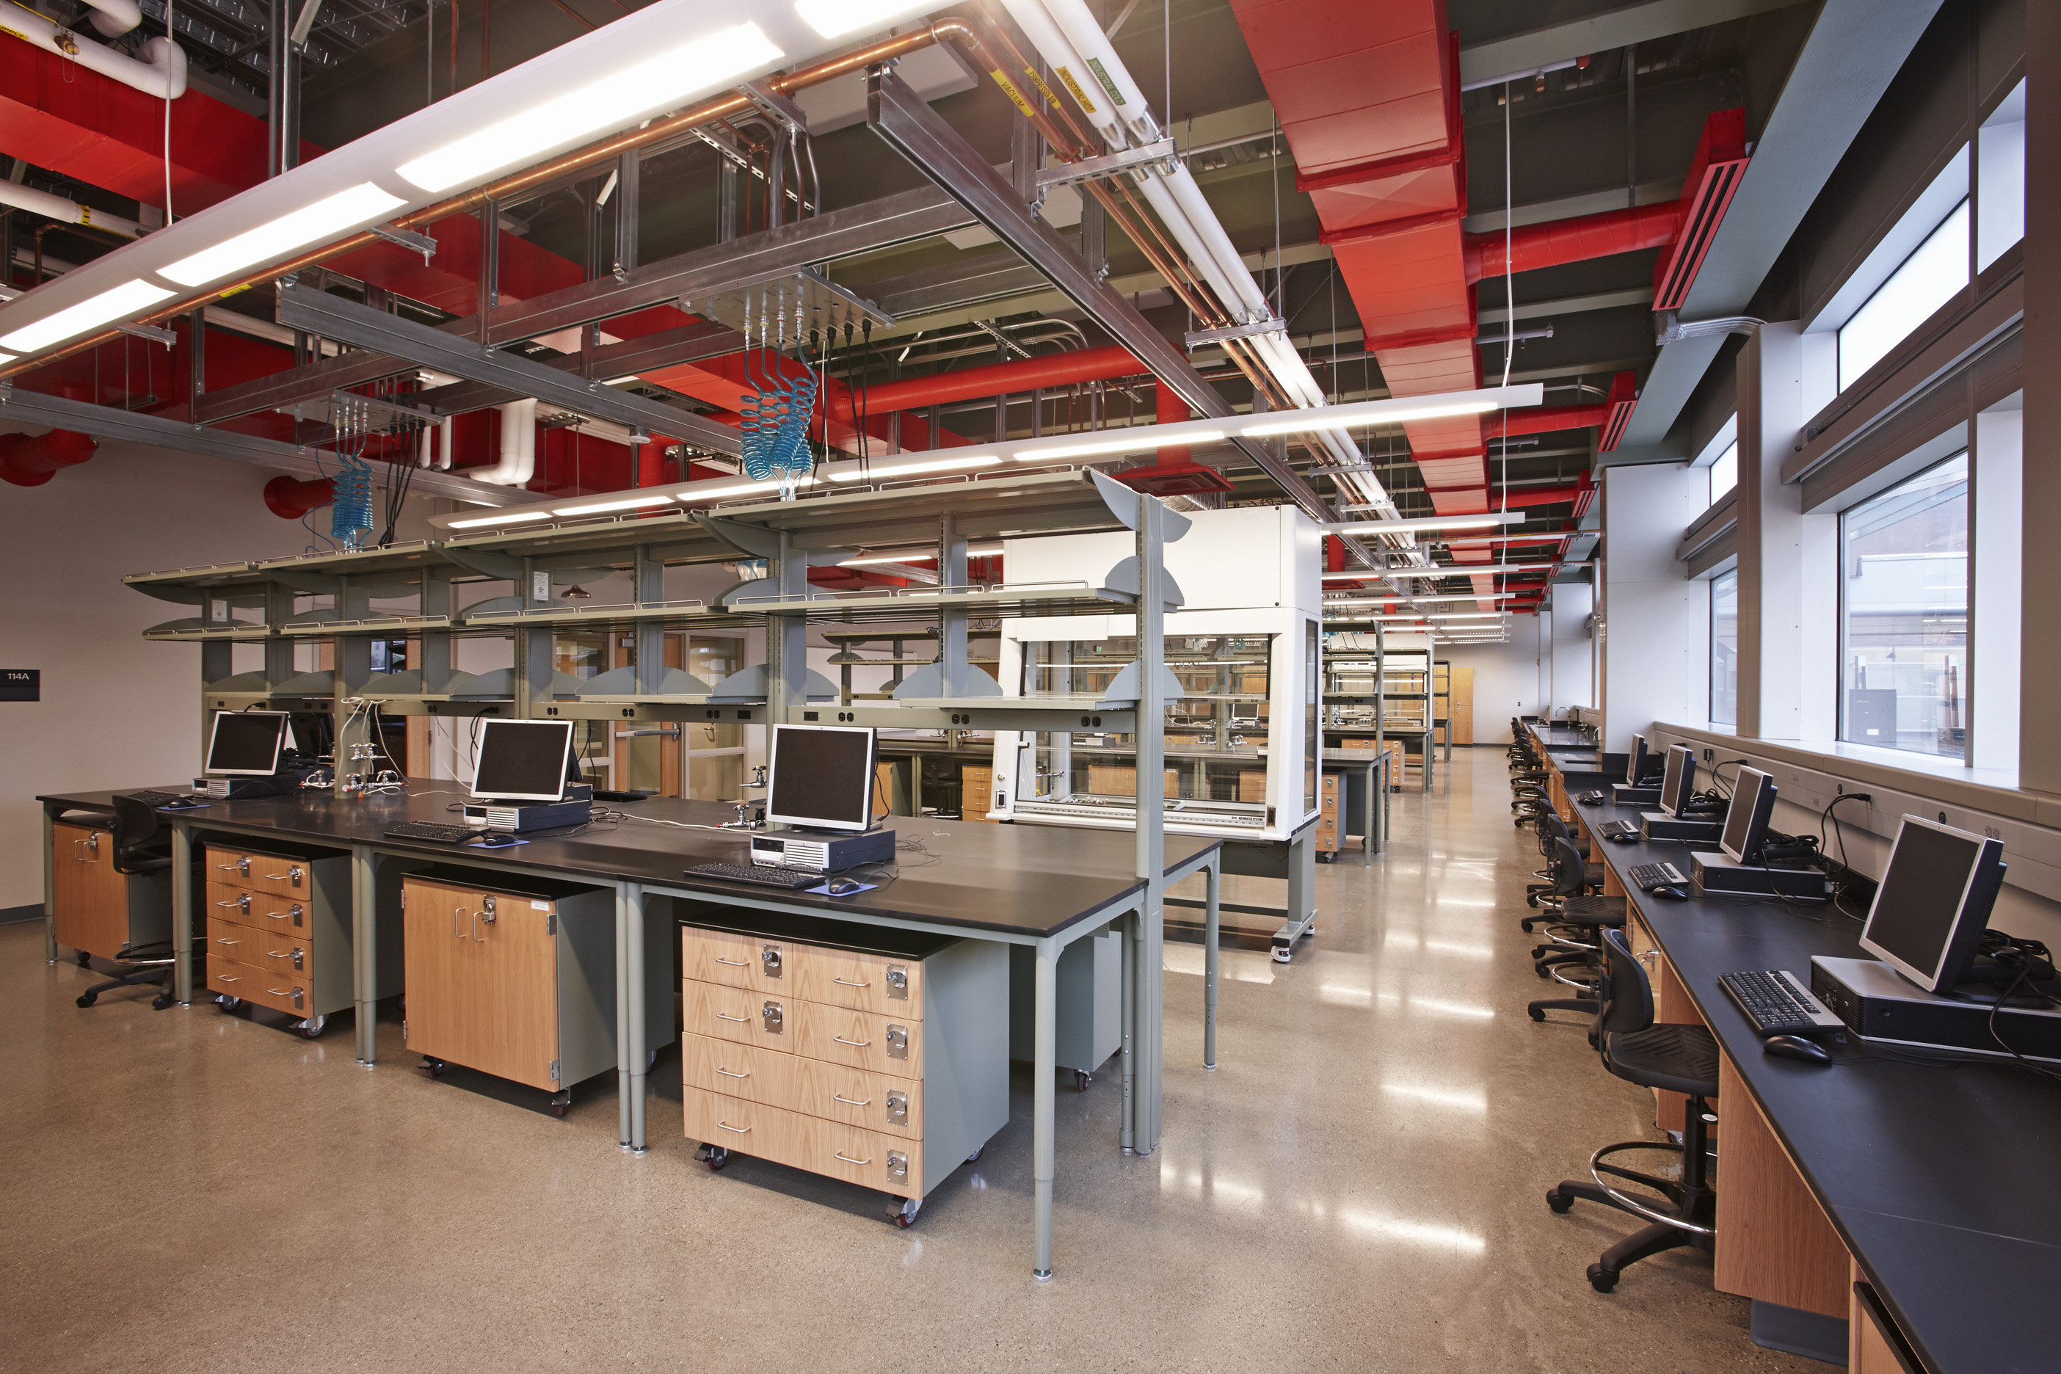
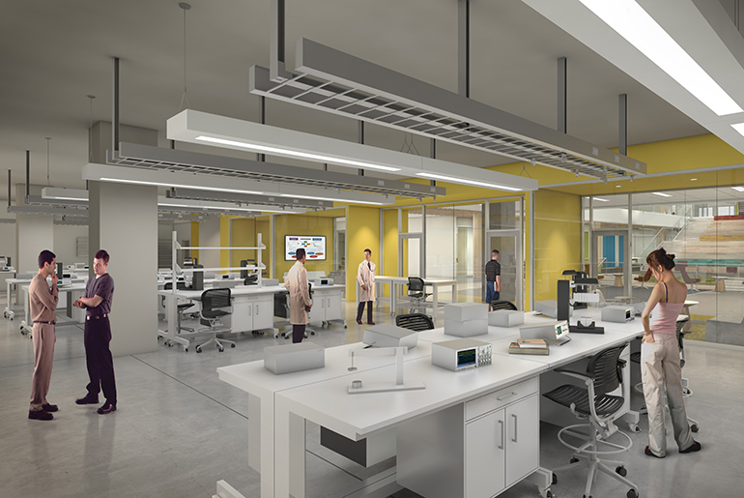
Key Facilities
Digital Library with Journals & E-learning Material
State-of-the-art Computing Labs
Separate Hostels for Boys & Girls
with Attached Bathrooms
High-speed Wi-Fi enabled campus

Slide 8
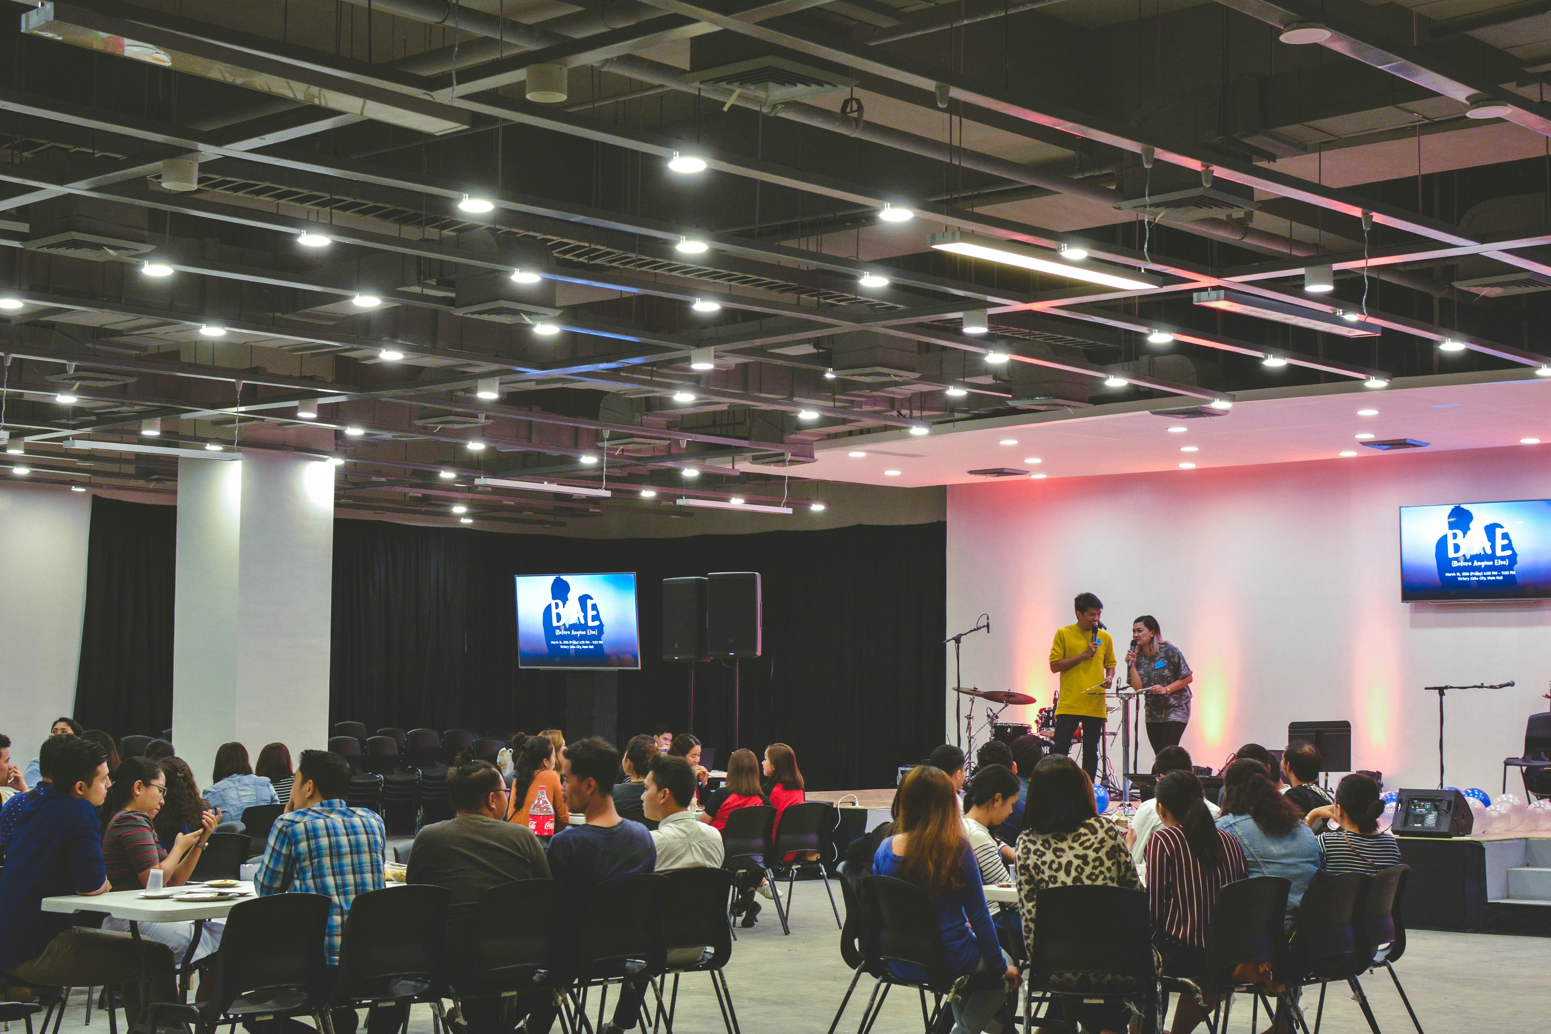

Placements & Security
Dedicated Campus Placement Cell
24/7 Security with CCTV surveillance
Frequent campus drives and placement
support
Partnerships with top recruiters

Slide 9

Scholarships Available
PROVIDING FREE TUITION FEE AND HOSTEL FEE FOR EAPCET QUALIFIED SC/ST AND BC STUDENTS

Slide 10

Contact Information
Phone: 9398302073, 7729988041, 9110375020, 9949025527
Email:admissions.glbc@gmail.com
Website: www.glbc.ac.in
Address: Near Toll Plaza, NH-40, Chinnamachupalli, Chennur(M), Kadapa - 516162

Slide 11
Thank you

